Slide 1
Info-6079 Security Application Week 8
Classes and Encapsulation
Notes:
https://www.tutorialspoint.com/python3/python_classes_objects.htm
https://www.w3schools.com/python/python_classes.asp

Slide 2
Lecture will cover
Intro to OOP (Oblect Oriented Programming)
3 principles of OPP
Class
Creating a class
Defining a class
Class variables, Instance Variables, Methods
Encapsulation

Slide 3
Intro to OOP

Slide 4
What is OOP
OOP stands for Object-Oriented Programing
This allows use to create customized Objects
Allowing us to write procedural programming, a set of steps of a process.
An object has 2 characteristics:
Attributes – as variables
Behavior – functions/Methods
We use OOP to creating reusable code
Think of DRY – Don’t Repeat Yourself
Notes:
In lesson 2 we mentioned that Python interpreter sees everything as an object.
With OPP we can created our own customized object.
DRY meaning don’t write the same code multiple times in a program.

Slide 5
Why do we use OOP?
A way to structure a program that would bundle properties and behaviors into an individual objects.
Example:
Person
properties: Name, age, address, and others
behaviors: walking, talking, breathing, and running
Email:
properties: recipient list, subject, body, and others
behaviors: attachments, draft, and sending

Slide 6
Why do we use OOP?
To module concrete real world things
Cars, person, email, and companies.
Could also to program relations between objects
Relationship between Companies and employees
Relationship between students and courses

Slide 7
3 principles of OOP
Encapsulation
Inheritance
Polymorphism
In this lecture we are covering Encapsulation and the next lecture we will look at Inheritance and Polymorphism

Slide 8
Class
Notes:
How can we represent something more than a variable that holds a cost of something, name of a movie, or a list of your grades?
Ex: As we add a grade to our list we get the grade average for the semester as well as the overall grade point average.
What if you take the same test twice….. Only the highest grade counts.

Slide 9
What is a Class?
A blueprint or a template for an object
A class can be seen as a category
Defining similarities of objects in a class
A class is a description for objects been defined.
By defining variables and functions/Methods
These would be come the Attributes and Behaviors for objects

Slide 10
What is a class?
It does not hold any real data.
It is a blueprint for how the object should be defined.
It is the idea for how something should be
Notes:
Could also be seen as a form or a questionnaire, defining the information needed

Slide 11
What’s an object?
Notes:
How can we represent something more than a variable that holds a cost of something, name of a movie, or a list of your grades?
Ex: As we add a grade to our list we get the grade average for the semester as well as the overall grade point average.
What if you take the same test twice….. Only the highest grade counts.

Slide 12
What is an Object?
It is a unique instance of a class
An object takes the class blueprint and fills it with actual data.
Turns the idea described in the class to an “actual thing”. At least, represent something real in a program.

Slide 13
Relationship of object to class
Can have multiple instances (objects) of a single class.
One class can have multiple objects
Car class can is the blueprint of objects Toyota Camry, Honda Civic, Toyota RAV4, and so on.
Could have several of the same with different colours and years.
With out the class it would be difficult keeping track of which information is required and how to keep it.

Slide 14
Lets practice
Notes:
How can we represent something more than a variable that holds a cost of something, name of a movie, or a list of your grades?
Ex: As we add a grade to our list we get the grade average for the semester as well as the overall grade point average.
What if you take the same test twice….. Only the highest grade counts.

Slide 15
A class for a mobile phone?
What variables do we need?
Attributes of the phone
Ex: Phone Number, phone Carrier, WiFi capable, Screen, Battery, Camera, Charging Port, Power_On/Off, phone plain, Data_plan.
What methods do we need?
Behaviors of the phone
Ex: Turning on/off, receiving call, making a call, on Call, connecting to WiFi, using call plan, using data plain, navigating phone options, Taking pictures and etc.
Notes:
Attributes include number, carrier, WiFi cabable
Behaviors include on/off, turning on/off, receiving call, dialing a number, on conversation, connected/connecting to WiFi, browsing the internet

Slide 16
Object of a mobile phone
Variable examples
Phone number: (519) 555-6853
Screen: 16” INCH
Battery: 400MAH
Camera: 45px
Charging port: USB Charging port
WiFi capable: Yes
Phone plan: unlimited Canada wide
Data plan: 4G, 5G

Slide 17
Defining a Class in Python

Slide 18
Creating a Class:
A class definition starts with the keyword class fallowed by the name of the class and colon (:)
You can start then defining the class with a mixture of methods and two (2) types of variables
Class variables
Instance Variables

Slide 19
Modules
Modules are special function that are defined in a class.
Creating the behavior of a class.
__init__() Function is executed when the class is being initiated to create a new object.
This is a constructor or initialization methods
It’s called when a new instance of a class
With this method you can define or setup your object at creation.

Slide 20
Self parameter
Self parameter is a reference to the current instance of the class. It is used to access variables that belong to the class.
Self binds the attributes with the given arguments.

Slide 21
Class variables
Defined in the class but outside of a class method.
Class Variables are shared by every instances of the class.
By modifying a class variable affects all objects instances at the same time.
Meaning if an object relied on the default value of the class variable then the object value as the class value changes.

Slide 22
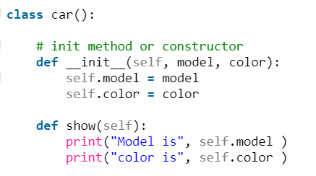
Instance Variables
Are Variables that are defined in a method and belongs only to the current instance of a class.
We use the self parameter to fill the in the Instance Variables
Notes:
It does not have to be named self , you can call it whatever you like, but it has to be the first parameter of any function in the class.
Recommendation use self to make sure that your code is clear keep using self.

Slide 23
Class Example

Slide 24
Class example
class clEmployee:
__num_of_Employees = 0 # Class variables that can
# only be reached from
# Method
def __init__(self, name, role): # Method
self.name = name # First Instance Variables
self.role = role # Second Instance Variables
self.__num_of_Employees()
def print_Employee_info(self):
print("{1} {0}".format(self.role, self.name))

Slide 25
Creating an object / instance of a class

Slide 26
Creating an instance of a class:
Give a name and assign it to the class
Using our Person example:
John = Person(“John Smith”, “Network Eng”)
The name “John Smith” and “Network Eng” are string variables required by the __init__ method
Notes:
If the constructer __init__ requires an int, float, list, or any other type you need to give it.
You can setup the constructer to accept anything or none.

Slide 27
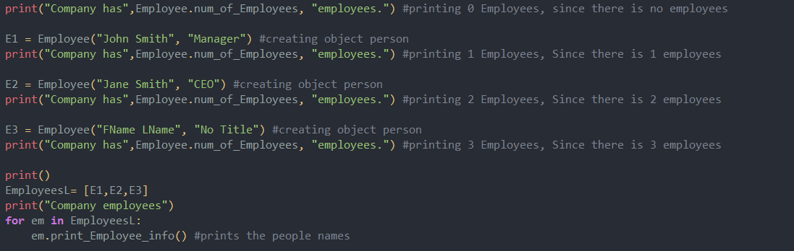
Calling class and printing

Slide 28
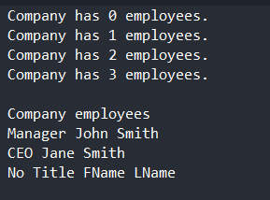
Output

Slide 29
Download and edit Lesson9_examples.py

Slide 30
Any Concerns with code?
class Employee:
__num_of_Employees = 0 # Class variables that can only be reached from a Method
def __init__(self, name, role): # Method
self.name = name # First Instance Variables
self.role = role # Second Instance Variables
self.__addEmployeeCount()
def print_Employee_info(self):
print("{0} {1}".format(self.role, self.name))
Where can variable num_of_Employees be changed?
How can it be accessed?
Do we want it to be accessed this way?
Notes:
To s

Slide 31
Concerns with this code?
class Employee:
__num_of_Employees = 0 # Class variables that can only be reached from a Method
def __init__(self, name, role): # Method
self.name = name # First Instance Variables
self.role = role # Second Instance Variables
self.__addEmployeeCount()
def print_Employee_info(self):
print("{0} {1}".format(self.role, self.name))
Employee.num_of_Employees =22
If we added Employee.num_of_Employees =22, just outside the class.
What would happen?
Notes:
To s

Slide 32
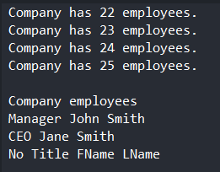
Output
Same amount of
objects but numbers
are off!
Do we want it to happen?
Can we stop it from happening?
Yes, we can!

Slide 33
Encapsulation
An object's attributes may or may not be visible outside the class definition.

Slide 34
Encapsulation
Encapsulation restricts access to methods and variables.
Prevents selected data from directly being modification. Not allowing changes to this data to be modified without preventions and restrictions, if at all.
In Python, we denote private attribute using underscore as prefix
i.e double “ __“.

Slide 35
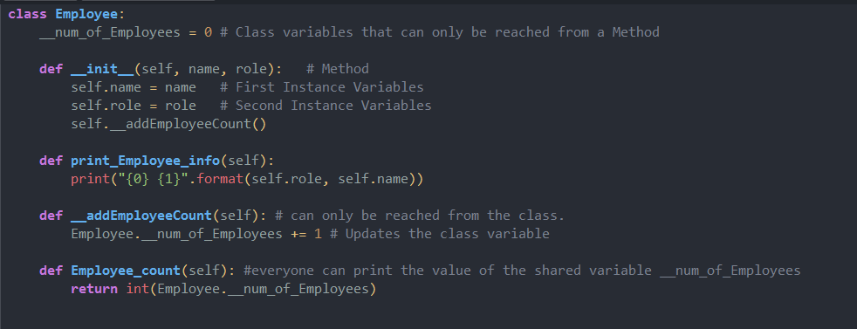
Changes to Employee Class
Notice added __ added to class variable
2 additional methods, one is private and another is public that returns Employee count

Slide 36
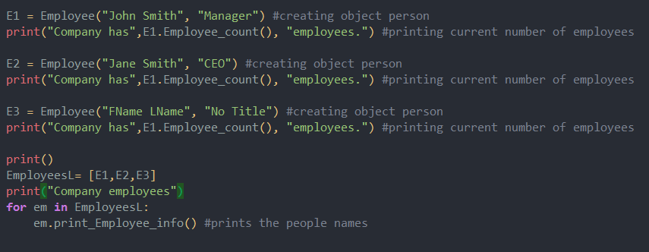
Call section edited
Changed Employee.num_of_Employees to E1.Employee_count() in print() function
Deleted the print function before E1 object
Notes:
In the print function you can use any employee object that has been created with the Employee_count() method. Each time the number return will be the employee count.

Slide 37
In the print function you can use any employee object that has been created with the Employee_count() method.
Ex. Can use E2 after it has been created and the same with E3
Used E1 since it’s the first and to show that the method uses the class variable.
Each time the number return will be the employee count.

Slide 38
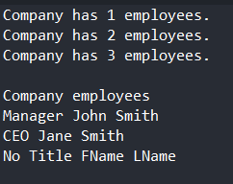
Output of Lesson9_examples_Encapsulation.py

Slide 39
Download and edit Lesson9_examples_Encapsulation.py
Try to see if you could add
Employee.__num_of_Employees = 22 or
E1.__Employee.num_of_Employees =22
Can you see the method if you type
Employee. Or E1.

